Slide 1

Identity and Access Management Service
March 10, 2025

Slide 2















Overview
IAM controls allow users (Employees, Contractors, Stakeholders, Suppliers, Vendors, End Customers and Guest Users) to access organization's resources seamlessly, rapidly and efficiently, so that the right user is granted the right access to the right protected resources under the right conditions/context at the right time.
Challenges
Growth Drivers
Deploy at scale & enforce adoption
Poor User Experiences & loss in productivity
Identity data issues – data inconsistency, data model
Consumer facing digital initiatives
Business collaboration & improved user experience
Identity centric zero trust initiatives towards
Cyber Risk Management
Manual IGA/PAM processes driving low operational efficiency, added time & cost
Increased cyber risk and non-compliance to regulations
Tech debt – legacy/redundant IAM toolsets & complex customizations
IAM controls playing a central role in increasing compliance requirements
IAM Tech refresh driven by legacy estates and/or cloud migrations
TCO concerns – Capex outlay
Lack of skills to deploy modern solutions
risk-managed interactions with vendors, partners and customers

Slide 3
Web Access Management

Slide 4
Introduction to Web Access Management
Web Access Management (WAM) is a subset of Identity and Access Management focused on controlling user access to web applications and resources​. In practice, WAM solutions handle authentication (verifying a user’s identity) and authorization (determining what that user can access) for web-based systems.
The purpose of WAM is to ensure only the right users get into the right applications, protecting sensitive data while streamlining user access​. This is critically important in modern enterprises – with so many web apps in use, a centralized WAM strategy helps maintain security and compliance while improving user convenience​.
WAM fits into the broader IAM ecosystem as the web-focused component that provides features like single sign-on, policy-based access control, and audit trails for web applications​. In short, WAM is the “gatekeeper” for web portals in an organization’s IAM program.

Slide 5
Core Concepts of WAM
Authentication vs. Authorization
Authentication is the process of verifying a user’s identity (e.g. prompting for username/password or an OTP).
Single Sign-On (SSO) & Federation:
SSO means a user can log in once and gain access to multiple applications without re-entering credentials each time.
Access Control Models (RBAC & ABAC):
WAM applies access policies often using Role-Based Access Control or Attribute-Based Access Control.
Session Management & Security:
Once authenticated, WAM manages a session for the user’s web access – often via a session cookie or token that keeps the user logged in across pages or apps.
Authorization happens after authentication and is the process of granting or denying access to specific resources based on policies or roles.
In simple terms: authentication = “Who are you?”, authorization = “What are you allowed to do?”.
WAM handles both – first confirming who the user is, then enforcing what that user can access.
In RBAC, permissions are tied to roles (job functions) and users are assigned roles – e.g., a “Manager” role grants access to certain web pages.
In ABAC, access is determined by evaluating attributes about the user, resource, and context (e.g., department = Finance, resource sensitivity = confidential, access time = work hours).
ABAC allows more granular, dynamic decisions but is more complex to implement. Modern WAM systems may use RBAC, ABAC, or a combination to define who can access what.
Secure session management is vital: the WAM system ensures session tokens are protected (HTTPS, secure cookies, etc.) and expire appropriately to prevent misuse.
WAM solutions use measures like token encryption, idle timeouts, and tying sessions to client attributes and authentication methods like MFA.
WAM solutions provide SSO convenience by sharing a session token or cookie across trusted applications.
Federation extends this idea across organizational or domain boundaries – it allows a user’s SSO to work for applications in different domains or companies through trust agreements.
Federated identity management uses standards like SAML or OIDC so that an identity from one domain (e.g. a corporate IdP) is accepted in another domain (a partner’s application).
The key difference: SSO is typically within one organization, while federation enables SSO across multiple organizations or security domains.

Slide 6

WAM Reference Architecture
Remote Access Solutions
Access from Public Network
Secure access to apps
Federated SSO
SAML or RADIUS
Applications & Systems
WAM B2E Platform
MDM
CIEM
SaaS Apps, Third Party Apps, Cloud Consoles
CASB
PEP
MFA
Identity Verification & Proofing
Application Landing Page
Trusted User
Risk/Contextual Authn
Username & Password
Fine-Grained Authz
(PAP, PDP, PIP)
Federated SSO
SAML / OIDC / OAuth2.0
HTTP Header for Legacy Apps
API GW
Microservices – API’s
Trusted Device
SSO + RBAC
Authenticator App ToTP/PushAuth
B2E Users
Access from Corporate Network
WAM
Gateway
On-prem & Legacy Apps
Mobile Apps
PEP
User Store
SSO & MFA
Enforce PAM Controls
Native-IOS & Android
Browser
Privilege Access Management
Windows, Linux, DB, etc.
Federated SSO
Enforce IGA Controls
Auditing & Security Analytics Layer
Identity Governance & Administration
WAM Core Components
Enforce IGA Controls
Other IAM Components
Cyber Security Components

Slide 7
Common Protocols in WAM
SAML 2.0 (Security Assertion Markup Language)
An XML-based standard for exchanging authentication and authorization data between an Identity Provider (IdP) and a Service Provider (SP).
OAuth 2.0
An authorization framework that allows users to grant third-party applications limited access to their resources without sharing passwords.
OAuth is commonly used for delegating access (e.g., allowing an app to access our profile or data on another service).
OpenID Connect (OIDC)
A simple identity layer on top of OAuth 2.0 that adds user authentication.
SAML is widely used in enterprise SSO scenarios. Ex. when we click “Login with Corporate ID” on a third-party site, a SAML message authenticates us through the company’s IdP and trusts us to the external SP.
In WAM context, OAuth underpins many “Login with X” features and API access scenarios by issuing tokens. However, OAuth by itself is about authorization (not identity) – that’s where OIDC comes in.
OIDC issues an ID Token (often a JWT) containing user identity info after an OAuth login flow.
This has become popular for modern web and mobile SSO because it’s lightweight (uses JSON/REST vs. SAML’s XML) and works well with OAuth-friendly platforms.

Slide 8
Key Takeaways
WAM’s Role in IAM
Plays a crucial role in an enterprise by acting as the front door to web applications.
Ensures that the right people get in with the right level of access
It relieves individual applications from having to manage their own user logins and sessions.
This centralization brings consistency and security –uniform password policies, session timeouts, and access rules across all web apps via WAM can be enforced.
Enable Multi-Factor Authentication (MFA): WAM can prompt for a second factor for sensitive applications or for all logins, which greatly improves security
Least Privilege & Role Management: Design the access roles/policies carefully so that users only have access to what they truly need.
Centralize and Automate: Use WAM’s self-service and automation features – e.g., self-service password reset and automatic de-provisioning of access when someone leaves
Monitor and Audit: Take advantage of WAM’s logging. Regularly audit the access logs and reports to spot anomalies (e.g., an account trying to access a restricted app repeatedly could indicate a possible breach attempt). Tie this into the security monitoring.
User Education and UX: Educate end-users about the new login process (for instance, a single sign-on portal) to ease adoption. Also customize the user-facing pages (login screen, error messages) for a smooth user-experience.
Best Practices for Implementing WAM
Zero Trust architecture: instead of assuming users inside the corporate network are trustworthy (which old WAM often did), Zero Trust mandates continuous verification of user identity, device, and context for every access.
Passwordless authentication: technologies like WebAuthn, biometrics, and passkeys may reduce reliance on the traditional username/password that WAM has long managed.
API access management: As applications have shifted to API and microservice architectures, WAM is converging with API access management - the same SSO and authorization concepts are being extended to RESTful services and SPAs (single-page apps) via OAuth tokens and JWTs.
Continuous authentication and AI-driven security: monitoring user behavior post-login and re-authenticating or limiting sessions if something seems off (for example, an account suddenly downloading massive data might trigger a re-auth check).
Current & Future Trends in WAM

Slide 9





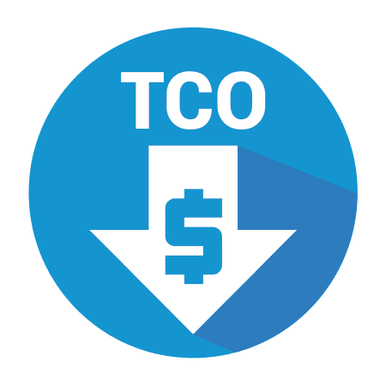
Web Access Management – Important Aspects
Prevent Breaches
Highly Automated &
Policy Based
Enable Remote &
Cloud Transformation
Cloud Neutral &
Broadest Token Types
Simplify Compliance
AM & MFA Combined
Better TCO

Slide 10
Customer Identity and Access Management

Slide 11
Introduction to CIAM
What is CIAM
Differences between IAM and CIAM
Importance of CIAM
Customer Identity and Access Management (CIAM) refers to managing external customer identities for a business’s apps and websites, focusing on providing seamless, secure access to users.
CIAM is tailored to customer-facing scenarios – enabling users to self-register, log in, authenticate, and manage their profiles and consent preferences on their own.
It combines security and user experience: CIAM helps organizations deliver frictionless login experiences across web and mobile channels while protecting customer data and accounts.
Seamless User Experience: Smooth registration and login processes (e.g. social login, single sign-on) reduce friction for customers, leading to higher satisfaction and loyalty.
Robust Security: Enhanced authentication (MFA, risk-based checks) helps prevent fraud and account takeovers without overly burdening users. CIAM creates secure, trusted interactions between customers and the business.
Scalability: Designed to handle millions of users and unpredictable traffic spikes, unlike internal IAM which only supports a fixed employee count. CIAM systems can grow with business demand.
Compliance: Built-in consent and privacy management to meet regulatory requirements (users give consent for data use, data is handled per GDPR/CCPA guidelines) – avoiding legal risks and building user trust through transparency.
Scope of Users: Traditional IAM (Identity & Access Management) is internal-facing, managing access for an organization’s employees and workforce. Its primary goal is to enforce security and proper access inside the company. CIAM, on the other hand, is external-facing, dealing with customers or consumers who use the company’s digital services.
User Experience vs. Control: IAM deals with employees who are trained to handle extra steps as it protects company data. In contrast, customers will not tolerate friction – a complicated sign-up or login process means they may give up and go elsewhere. Thus, CIAM places a greater emphasis on user experience and self-service. Customers can register themselves, reset passwords, and use familiar logins (like Google/Facebook) without calling IT support.
Scale and Performance: An IAM system might support a workforce of, say, 5,000 employees, with predictable login patterns. CIAM must support possibly 5 million customers with spiky, 24/7 usage.
Features and Compliance: Both IAM and CIAM involve authentication, authorization, and directory services, but CIAM extends functionality to meet consumer needs. For example, CIAM commonly offers social login integration, consumer privacy consent, and marketing profile data – features not needed in internal IAM.

Slide 12
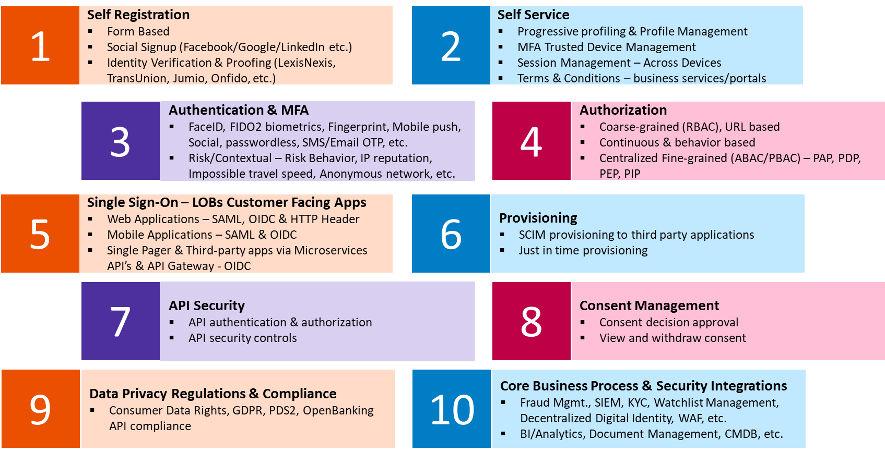
CIAM - Key Use Cases

Slide 13
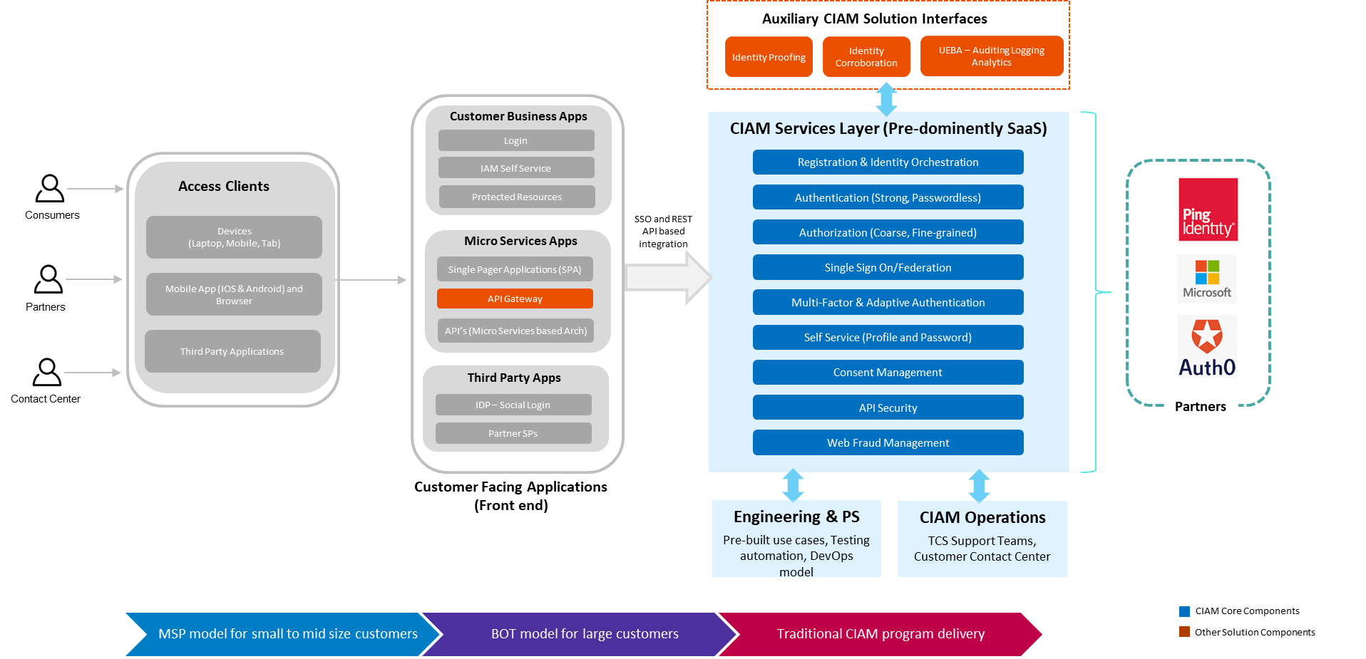
CIAM Offering Overview

Slide 14
Key Takeaways of CIAM
Implement strong authentication and monitoring. Use modern password policies (or go passwordless where feasible) and enable MFA options – educate users on why MFA benefits them (protects their account).
CIAM is essential for businesses engaging customers online – It provides the secure, seamless digital experiences that modern consumers expect. Unlike internal IAM, CIAM directly impacts customer satisfaction and trust, which in turn drives business growth.
The best practice in CIAM is to minimize friction at every step of the user journey – from registration to login to account recovery. Use features like social login, single sign-on, and remember-me to streamline access.
Make privacy compliance a core part of your CIAM implementation from the start. Always ask for user consent for data collection and clearly explain how their data will be used.
When rolling out CIAM, design for the “best case scenario” – i.e., if the user base growing rapidly we need to choose architectures (or vendors) that can scale to millions of accounts and handle spikes (like a product launch causing thousands of logins per second).
Zero Trust mindset: just because it’s a customer doesn’t mean you trust their device or network – always verify and use context to make access decisions. Also ensure proper API security if your CIAM exposes APIs (use rate limiting, OAuth scopes, etc., to prevent abuse).
Key Takeaways

Slide 15


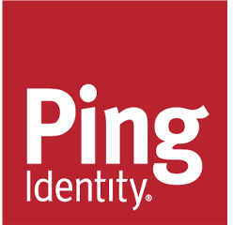


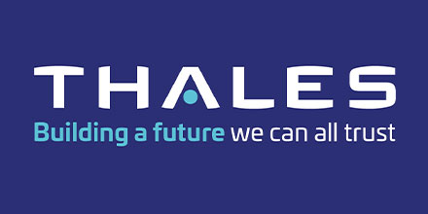
Alliances & Partnerships in CIAM space

Slide 16
Identity Governance & Administration

Slide 17
IGA Overview
Definition
Identity Governance and Administration (IGA) is about managing who has access to what within an organization, ensuring users have the right access at the right time and nothing more.
Why It Matters
Prevents unauthorized access and data breaches.
Key Idea
Centralize & automate access lifecycle (joiners, movers, leavers).
Satisfies compliance with regulations (e.g., GDPR, SOX).
Reduces risk by removing excessive or outdated privileges.
Track and review access privileges regularly to maintain security.

Slide 18
Core Functions of IGA
Identity Lifecycle Management
Automate onboarding for new hires (creating accounts/permissions).
Manage role changes (transfers, promotions), and handle offboarding (removing access).
Access Requests & Approvals
Provide a self-service portal where users can request access.
Managers or application owners review/approve requests, ensuring accountability.
Define roles based on job functions (e.g., “HR Manager,” “Finance Analyst”).
Enforce policies like least privilege or separation of duties (e.g. a user can’t both approve and pay invoices).
Role & Policy Management
Automated Provisioning & Deprovisioning
Integrate with HR systems or directories to auto-update user access as roles change.
Immediately remove access for departing employees, preventing lingering accounts.
Access Certification & Review
Conduct periodic reviews so managers confirm who truly needs what access.
Revoke unnecessary privileges to maintain compliance and reduce risk.
Audit & Compliance Reporting
Track who has access to which systems and when changes occurred.
Generate audit reports for regulators and demonstrate adherence to standards (e.g. GDPR, SOX).

Slide 19
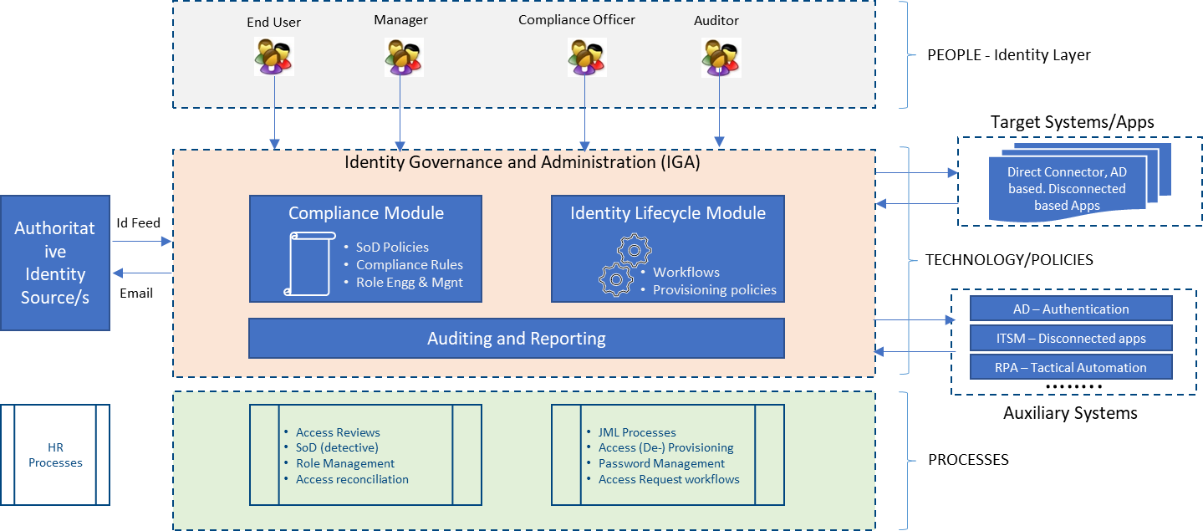
IGA Reference Architecture

Slide 20
Real-World Example & Leading IGA Solutions
Real-World Example
A large company found many ex-employees still had active accounts—a big security risk!
Leading IGA Solutions
SailPoint: Known for strong access certification features and automated provisioning.
Key Takeaways
IGA ensures visibility, control, and compliance for user access.
By deploying an IGA solution, they automated deprovisioning (removing old accounts) and set up regular access reviews.
This drastically reduced unauthorized access, closing security gaps.
Saviynt: Cloud-friendly IGA platform offering detailed analytics and governance for apps/databases.
One Identity: Offers role-based provisioning, access reviews, and compliance reporting in a unified platform.
It brings structure and automation to user onboarding, offboarding, and privilege review.
A solid IGA strategy protects sensitive data while supporting business operations smoothly.

Slide 21
Privilege Access Management

Slide 22
PAM Overview
What is PAM?
A security strategy that controls and monitors high-level access within an organization.
Why is it Important?
Common Privileged Accounts
System Admin (full control of servers/networks).
Privileged accounts hold the “keys to the kingdom” — if compromised, attackers can access or damage critical systems.
Focuses on “privileged” accounts with elevated permissions (e.g., administrators, root users).
Ensures safeguards for sensitive operations, reducing the risk of major security breaches.
Helps meet compliance requirements (SOX, GDPR, etc.) by managing who can access critical data.
Database Admin (access to entire databases).
Application Admin (manages critical software platforms).
Key Benefits of PAM
Stronger Security: Reduces chances of malicious insiders or external threats gaining full control.
Better Accountability: Clear records of “who did what” on sensitive systems.
Simplified Auditing: Centralized logging for compliance and incident investigations.

Slide 23
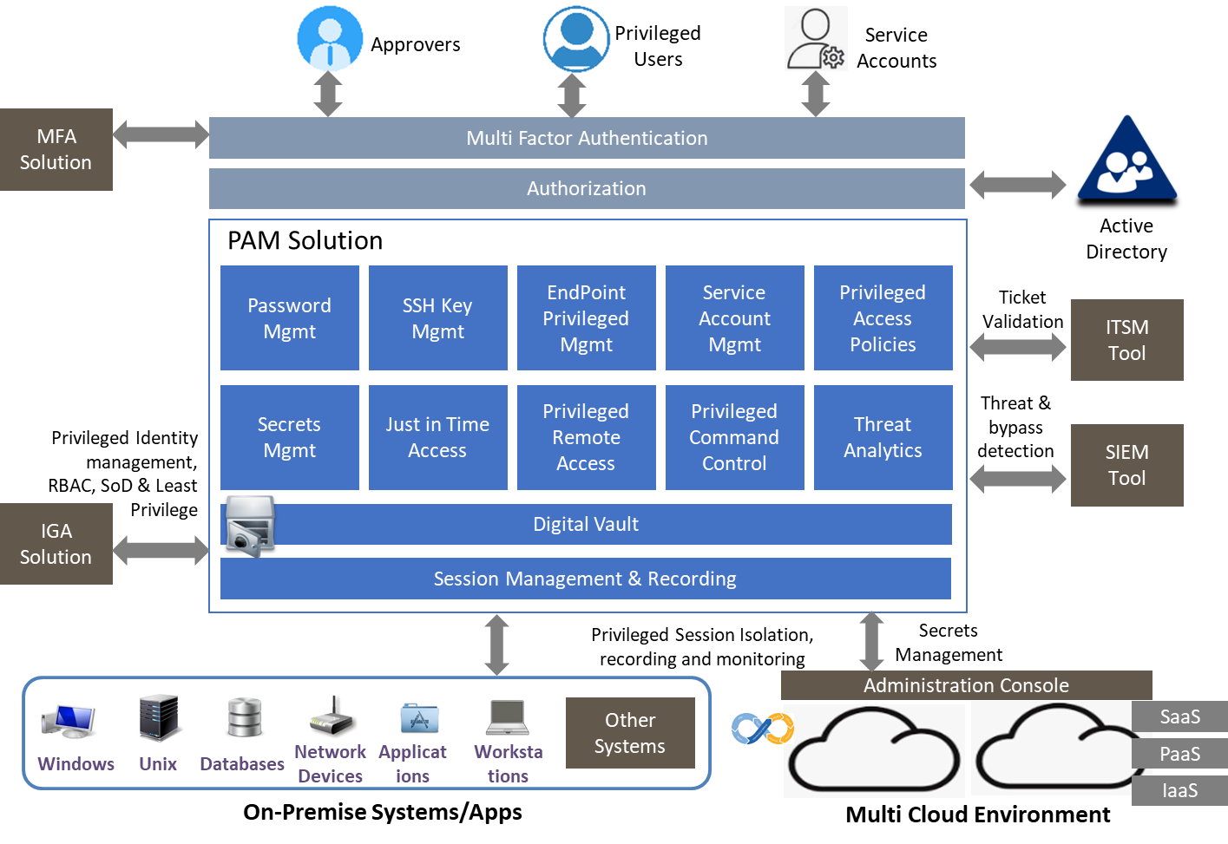
PAM Reference Architecture

Slide 24
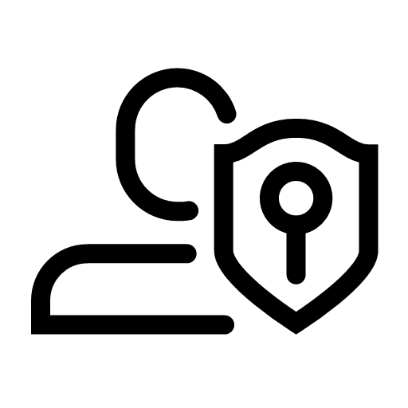
Key Components of a PAM Solution
Stores admin passwords and keys in an encrypted repository.
Ensures regular rotation of privileged credentials (e.g., auto-changing passwords).
Credential Vault
Session Management & Recording
Monitors and logs privileged user actions (e.g., keystrokes, commands).
Enables real-time alerts and potential session termination if suspicious activity is detected.
Grants temporary elevated access when needed (instead of always-on admin rights).
Reduces the window of opportunity for attackers to exploit privileged accounts.
Just-In-Time Privileges
Access Workflows & Approvals
Automates approval processes for privileged access requests.
Ensures accountability (e.g., a manager must approve higher-level access before it’s granted).
Least Privilege & Access Policies
Ensures users only get minimum privileges required.
Enforces role-based or attribute-based controls for tighter security.
Audit & Reporting
Maintains detailed logs of who used privileged accounts, when, and why.
Simplifies compliance by providing easy-to-generate audit reports for regulators.

Slide 25
Overview of Leading PAM Solutions
CyberArk:
A market-leading PAM platform known for its comprehensive credential vaulting and session monitoring. CyberArk supports complex enterprise environments and integrates with cloud platforms, providing adaptive MFA and just-in-time access across on-prem and cloud assets​. (CyberArk is often cited as the “gold standard” for vaulting privileged passwords.)
BeyondTrust:
A PAM suite offering privileged password management, session management, and endpoint least privilege enforcement. BeyondTrust can discover privileged accounts across Windows, Linux, network devices, and even apply policies on end-user workstations to remove local admin rights​. It’s valued for a unified view of privileged activities and strong analytics for risk reporting.
Delinea (Thycotic/Centrify):
A user-friendly PAM solution that emphasizes ease of deployment and cloud readiness. Delinea provides an encrypted Secret Server vault for credentials, with policy-based access controls and automated password rotation​. It also offers just-in-time provisioning and scalable options for hybrid cloud environments, aligning with zero trust principles​. (Delinea is the result of a merger between Thycotic and Centrify, combining strengths in password safety and identity-centric control.)

Slide 26
PAM Best Practices
Enforce Multi-Factor Authentication (MFA): Always require MFA (e.g. token or biometric) for logging into privileged accounts or PAM portals. Even if an attacker steals a password, the second factor stops them.
Adopt Least Privilege & JIT everywhere: Give users the lowest level of privilege they need and no more. Use just-in-time elevation so that permanent admin rights are eliminated.
Monitor and audit continuously: Continuously monitor privileged sessions and keep detailed audit logs. PAM tools should track who accessed what, when, and what they did.
Automate credential management: Eliminate hard-coded or shared passwords by vaulting them and automating password rotations on a schedule.
Embrace Zero Trust and advanced defenses: Modern PAM is moving toward a Zero Trust model, where no user is inherently trusted simply by being inside the network.
PAM Best Practices

Slide 27
Decentralized Identity

Slide 28
Decentralized Identity Overview
What is Decentralized Identity (DI)?
A new way of managing digital identities where individuals control their own data.
Why It’s Important
Privacy & Security: No giant database to hack; users decide what data to share and with whom.
Key Benefits
Full Control: You’re in charge of your digital identity details (no middleman).
Unlike traditional systems (centralized), there’s no single “authority” holding all your info.
User Empowerment: People own their credentials (e.g., ID cards, certificates) instead of relying on big corporations.
Reduced Fraud: Uses cryptographic proofs (like blockchain) so it’s much harder to fake or tamper with credentials.
Interoperable: Use the same verified credentials across multiple platforms.
Better Trust: Organizations can verify credentials quickly, without storing them all in a central place.

Slide 29
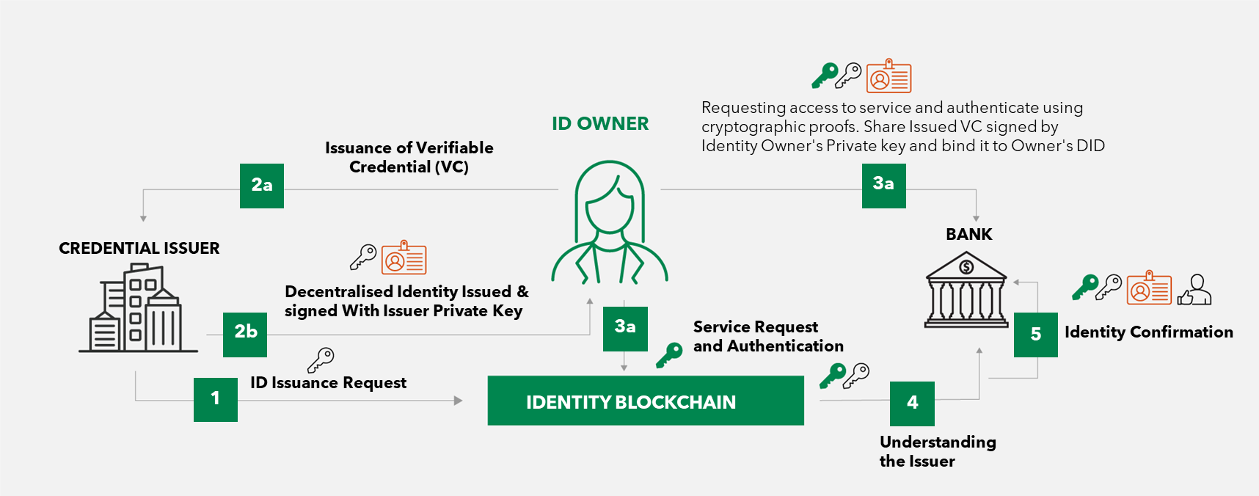
Decentralized Identity Model

Slide 30
How Decentralized Identity Works
How Decentralized Identity Works
Blockchain-Based Identity: Uses distributed ledgers (like blockchain) to store public keys or identity references securely.
Key Components
Decentralized Identifiers (DIDs): Unique IDs stored on a blockchain.
Real-World Examples
Digital Driver’s License: Government issues a verifiable credential; users store it in a phone wallet.
Self-Sovereign Identity (SSI): Puts users in control of their own credentials (e.g., driver’s license, employee badge).
Credentials are digitally signed by trusted issuers and stored in the user’s wallet (not a central server).
Verifiable Credentials (VCs): Digitally signed proofs users hold in their wallet (e.g., driver’s license).
Verification Process: A service checks the issuer’s signature against the blockchain to confirm authenticity.
University Degrees: Universities issue tamper-proof e-diplomas; employers validate quickly without calling the school.
Banking KYC: A bank verifies your ID once, then you can reuse that verified credential elsewhere.

Slide 31
Policy Based Access Control

Slide 32
Introduction to Fine-Grained Authorization
Authentication vs. Authorization
A method of access control that uses multiple, detailed conditions (not just a user’s role).
Why It’s Important
Ensures each user only sees the specific data and functions they truly need.
Key Difference from Coarse-Grained
Coarse-Grained: Broad permissions, typically role-based (e.g., “All managers see all reports”).
Common Use Cases
Healthcare: Nurses can only edit certain patient details, doctors can access specific patient records.
Decides who can do what based on attributes (e.g., department, time of day, data type).
Reduces risk of unauthorized access or accidental misuse.
Helps with compliance by enforcing strict, tailored permissions.
Fine-Grained: More specific (e.g., “Managers see only reports for their department during business hours”).
Banking: Loan officers see only their assigned loans; approvals require extra conditions (e.g., manager sign-off).
Key Benefits
Enhanced Security: Limits damage if an account is compromised.
Precise Control: Adapts to complex business policies.
Least Privilege Principle: Each role has just what they need, nothing more.

Slide 33
How Decentralized Identity Works
Role-Based Access Control (RBAC):
Permissions are tied to job roles (e.g., “Admin,” “Manager,” “Teller”).
All users in the same role typically share identical privileges.
Easy to implement but can become too broad (everyone in a role sees everything).
Attribute-Based Access Control (ABAC):
Decisions use attributes of the user, resource, and context (e.g., department, location, time).
More granular and flexible (e.g., “Only allow access if user.role = ‘Manager’ AND region = ‘APAC’”).
Ideal for complex environments where simple roles aren’t enough.
Real-World Examples:
Banking: A teller sees only local branch transactions under a set amount; a branch manager sees higher-value transactions for their region.
Healthcare: A nurse can view patient vitals on their shift but cannot change doctors’ treatment notes; a doctor’s access is limited to their assigned patients.

Slide 34
Best Practices & Key Takeaways
Principle of Least Privilege
Grant only the minimum access needed for each task.
Centralized Policy Management
Use a policy engine (e.g., ABAC framework) instead of scattered, manual rules.
Regular Access Reviews
Conduct periodic audits to confirm users still need their assigned privileges.
Prevents accidental or malicious misuse of high-level permissions.
Easier to update, review, and enforce organization-wide.
Revoke unnecessary permissions to reduce security risks.
Combine Roles & Attributes
Detailed Logging & Auditing
Track who accessed what, when, and why.
Helps detect anomalies and meet compliance requirements.
Mix RBAC (roles) with ABAC (attributes like location, time, department) for granular access decisions.
Achieves a balance of simplicity and precision.

